Slide 1
http://yellkey.com/subject
To what degree do you believe the following statement: Nearly anybody enrolled at Berkeley could achieve an A in CS61B.
Assume they can spend the entire summer preparing beforehand, hire a tutor during the semester, etc.
Strongly disagree
Disagree
Neutral
Agree
Strongly agree

Slide 2
Growth vs. Fixed Mindset
Students can be thought of as having either a “growth” mindset or a “fixed” mindset (based on research by Carol Dweck).
“In a fixed mindset students believe their basic abilities, their intelligence, their talents, are just fixed traits. They have a certain amount and that's that, and then their goal becomes to look smart all the time and never look dumb.”
Perhaps most damningly, having to put in effort is a sign of weakness!
“In a growth mindset students understand that their talents and abilities can be developed through effort, good teaching and persistence. They don't necessarily think everyone's the same or anyone can be Einstein, but they believe everyone can get smarter if they work at it.”
Growing up and even through undergrad I was very much part of the “fixed mindset” camp.

Slide 3
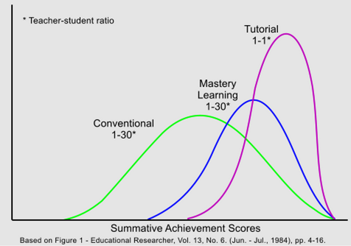
A Brief Aside
Bloom’s Two Sigma Problem: In one experiment, student randomly picked for 1-on-1 teaching performed similarly to the top 2% of a simultaneous lecture course.

Slide 4
A Supporting Experiment
In Sp16, I gave students the option to fail intentionally.
On average, students were 2.5 letter grades higher the second time, e.g. someone in the middle of the B range got an A the second time.
Possible interpretation: There exists some sort of preparation for 61B that helps students do much better.

Slide 5
Announcements
HW2 due next Wednesday.
Will be out late tonight.
Application of disjoint sets towards a cool physics problem.
Roundtable discussions about project 2 approximately next Thursday: (Link)
If demand is high, will select people randomly.

Slide 6
Announcements
Project 2. Some lessons:
API design is hard. Your first design is probably going to be ugly.
Modular design is important.
If something is ugly and works, you can refactor your code so that it still works and is less ugly.
Your choice of classes and underlying data structures make a critical difference in how hard your code is to implement.
Working on a team has a complex human dimension and can be anywhere between infuriating and wonderful.
For more software engineering, see CS169.
Future HWs and project 3 will not feel quite like this one.

Slide 7
Announcements
How should you do well on midterm 2?
Go through the study guides soon after the relevant lecture.
Work on study guide problems independently, and discuss solutions with others.

Slide 8
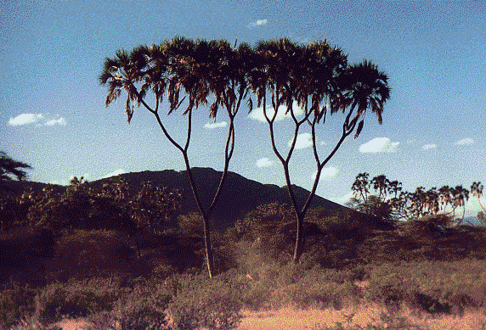
CS61B
Lecture 21: Binary Search Trees
Binary Search Tree (intro)
BST Definitions
BST Operations
Performance

Slide 9
Analysis of an OLLMap<Character, ?>
In an earlier lecture, we implemented a map based on unordered arrays. For the order linked list map implementation below, name an operation that takes worst case linear time, i.e. Θ(N).
A
B
C
D
E
F
G
7
sent
size
get
size
containsKey
put
clear
For space reasons, only keys are shown!
Values are not relevant to the discussion today.
Notes:
8:19 begin

Slide 10
Analysis of an OLLMap<Character, ?>
In an earlier lecture, we implemented a map based on unordered arrays. For the order linked list map implementation below, name an operation that takes worst case linear time, i.e. Θ(N).
A
B
C
D
E
F
G
7
sent
size
get
size
containsKey
put
clear
For space reasons, only keys are shown!
Values are not relevant to the discussion today.
Notes:
8:19 begin

Slide 11
Optimization: Extra Links
Fundamental Problem: Slow search, even though it’s in order.
Add (random) express lanes. Skip List (won’t discuss in 61B)
A
B
C
D
E
F
G

Slide 12
Optimization: Change the Entry Point
Fundamental Problem: Slow search, even though it’s in order.
Move pointer to middle.
A
B
C
D
E
F
G

Slide 13
Optimization: Change the Entry Point, Flip Links
Fundamental Problem: Slow search, even though it’s in order.
Move pointer to middle and flip left links. Halved search time!
A
B
C
D
E
F
G

Slide 14
Optimization: Change the Entry Point, Flip Links
Fundamental Problem: Slow search, even though it’s in order.
How do we do even better?
Dream big!
A
B
C
D
E
F
G

Slide 15
Optimization: Change Entry Point, Flip Links, Allow Big Jumps
Fundamental Problem: Slow search, even though it’s in order.
How do we do better?
A
B
C
D
E
F
G
D
B
F
A
C
E
G
Notes:
3 minutes from start of this section

Slide 16
BST Definitions

Slide 17
Tree
A tree consists of:
A set of nodes.
A set of edges that connect those nodes.
Constraint: There is exactly one path between any two nodes.
Green structures below are trees. Pink ones are not.

Slide 18
Rooted Trees and Rooted Binary Trees
In a rooted tree, we call one node the root.
Every node N except the root has exactly one parent, defined as the first node on the path from N to the root.
Unlike (most) real trees, the root is usually depicted at the top of the tree.
A node with no child is called a leaf.
In a rooted binary tree, every node has either 0, 1, or 2 children (subtrees).
A
A
A
For each of these:
A is the root.
B is a child of A. (and C of B)
A is a parent of B. (and B of C)
B
B
B
C
C
C
C
Not binary!

Slide 19
Binary Search Trees
A binary search tree is a rooted binary tree with the BST property.
BST Property. For every node X in the tree:
Every key in the left subtree is less than X’s key.
Every key in the right subtree is greater than X’s key.
dog
debt
bag
flat
bus
ears
alf
cat
elf
glut
axe
cow
fish
gut
Binary Search Tree
Binary Tree, but not a Binary Search Tree

Slide 20
Binary Search Trees
Ordering must be complete, transitive, and antisymmetric. Given keys p and q:
Exactly one of p ≺ q and q ≺ p are true.
p ≺ q and q ≺ r imply p ≺ r.
One consequence of these rules: No duplicate keys allowed!
Keeps things simple. Most real world implementations follow this rule.
dog
debt
bag
flat
bus
ears
alf
cat
elf
glut
axe
cow
fish
gut
Binary Search Tree
Binary Tree, but not a Binary Search Tree

Slide 21
BST Operations

Slide 22
Finding a searchKey in a BST (come back to this for the BST lab)
If searchKey equals label, return.
If searchKey ≺ label, search left.
If searchKey ≻ label, search right.
dog
bag
flat
alf
cat
elf
glut

Slide 23
Finding a searchKey in a BST
If searchKey equals label, return.
If searchKey ≺ label, search left.
If searchKey ≻ label, search right.
dog
bag
flat
static BST find(BST T, Key sk) {
if (T == null)
return null;
if (sk.keyequals(T.label()))
return T;
else if (sk ≺ T.label())
return find(T.left, sk);
else
return find(T.right, sk);
}
alf
cat
elf
glut

Slide 24
BST Search: http://yellkey.com/position
What is the runtime to complete a search on a “bushy” BST in the worst case, where N is the number of nodes.
Θ(log N)
Θ(N)
Θ(N log N)
Θ(N²)
Θ(2^{N})
“bushiness” is an intuitive concept that we haven’t defined.

Slide 25
BST Search
What is the runtime to complete a search on a “bushy” BST in the worst case, where N is the number of nodes.
Θ(log N)
Height of the tree is ~log₂(N)

Slide 26
BSTs
Bushy BSTs are extremely fast.
At 1 microsecond per operation, can find something from a tree of size 10³⁰⁰⁰⁰⁰ in one second.
Much (perhaps most?) computation is dedicated towards finding things in response to queries.
It’s a good thing that we can do such queries almost for free.

Slide 27
Inserting a new key into a BST
Search for key.
If found, do nothing.
If not found:
Create new node.
Set appropriate link.
Example:
insert “eyes”
dog
bag
flat
alf
cat
elf
glut
eyes

Slide 28
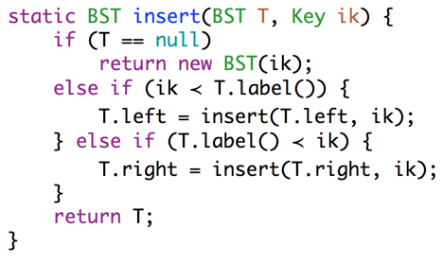
Inserting a new key into a BST
What would we do if the BST was implementing a map?
Search for key.
If found, do nothing.
If not found:
Create new node.
Set appropriate link.
dog
bag
flat
alf
cat
elf
glut
static BST insert(BST T, Key ik) {
if (T == null)
return new BST(ik);
if (ik ≺ T.label()))
T.left = insert(T.left, ik);
else if (ik ≻ T.label())
T.right = insert(T.right, ik);
return T;
}
ARMS LENGTH RECURSION!!!! No good.
eyes
A common rookie bad habit to avoid:
if (T.left == null)
T.left = new BST(ik);
else if (T.right == null)
T.right = new BST(ik);

Slide 29
Deleting from a BST
3 Cases:
Deletion key has no children.
Deletion key has one child.
Deletion key has two children.
dog
bag
flat
alf
cat
elf
glut
eyes

Slide 30
Case 1: Deleting from a BST: Key with no Children
Deletion key has no children (“glut”):
Just sever the parent’s link.
What happens to “glut” node?
dog
bag
flat
alf
cat
elf
glut
eyes

Slide 31
Case 1: Deleting from a BST: Key with no Children
Deletion key has no children (“glut”):
Just sever the parent’s link.
What happens to “glut” node?
Garbage collected.
dog
bag
flat
alf
cat
elf
glut
eyes

Slide 32
Case 2: Deleting from a BST: Key with one Child
Example: delete(“flat”):
Goal:
Maintain BST property.
Flat’s child definitely larger than dog.
Safe to just move that child into flat’s spot.
Thus: Move flat’s parent’s pointer to flat’s child.
dog
bag
flat
alf
cat
elf
eyes

Slide 33
Case 2: Deleting from a BST: Key with one Child
Example: delete(“flat”):
Goal:
Maintain BST property.
Flat’s child definitely larger than dog.
Safe to just move that child into flat’s spot.
Thus: Move flat’s parent’s pointer to flat’s child.
Flat will be garbage collected (along with its instance variables).
dog
bag
flat
alf
cat
elf
eyes

Slide 34
Hard Challenge
Delete k.
k
e
v
b
g
p
y
a
d
f
m
r
x
z

Slide 35
Hard Challenge
Delete k.
k
e
v
b
g
p
y
a
d
f
m
r
x
z

Slide 36
Case 3: Deleting from a BST: Deletion with two Children (Hibbard)
Example: delete(“dog”)
Goal:
Find a new root node.
Must be > than everything in left subtree.
Must be < than everything right subtree.
Would bag work?
dog
bag
flat
alf
cat
elf
glut
eyes

Slide 37
Case 3: Deleting from a BST: Deletion with two Children (Hibbard)
Example: delete(“dog”)
Goal:
Find a new root node.
Must be > than everything in left subtree.
Must be < than everything right subtree.
Choose either predecessor (“cat”) or successor (“elf”).
Delete “cat” or “elf”, and stick new copy in the root position:
This deletion guaranteed to be either case 1 or 2. Why?
This strategy is sometimes known as “Hibbard deletion”.
dog
bag
flat
alf
cat
elf
glut
eyes

Slide 38
Hard Challenge (Hopefully Now Easy)
Delete k.
k
e
v
b
g
p
y
a
d
f
m
r
x
z

Slide 39
Hard Challenge (Hopefully Now Easy)
Delete k. Two solutions: Either promote g or m to be in the root.
Below, solution for g is shown.
k
e
v
b
g
p
y
a
d
f
m
r
x
z

Slide 40
Hard Challenge (Hopefully Now Easy)
Two solutions: Either promote g or m to be in the root.
Below, solution for g is shown.
g
e
v
b
f
p
y
a
d
m
r
x
z

Slide 41
BST Performance

Slide 42
Tree Height
Height varies dramatically between “bushy” and “spindly” trees.
H=3
k
k
H=3
e
v
v
b
g
p
y
y
a
d
f
j
m
r
x
z
z

Slide 43
Tree Height: http://yellkey.com/type
Height varies dramatically between “bushy” and “spindly” trees.
H=3
k
k
H=3
e
v
v
b
g
p
y
y
a
d
f
j
m
r
x
z
z
Let H(N) be the height of a tree with N nodes. Give H(N) in Big-Theta notation for “bushy” and “spindly” trees, respectively:
Θ(log(N)), Θ(log(N))
Θ(log(N)), Θ(N)
Θ(N), Θ(log(N))
Θ(N), Θ(N)

Slide 44
Tree Height
Height varies dramatically between “bushy” and “spindly” trees.
H=3
k
k
H=3
e
v
v
b
g
p
y
y
a
d
f
j
m
r
x
z
z
H = Θ(log(N))
H = Θ(N)
Performance of spindly trees can be just as bad as a linked list!
Example: containsKey(“z”) would take linear time.

Slide 45
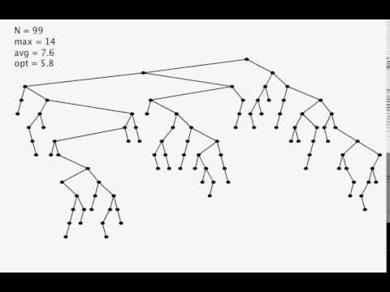
BST Insertion Demo
Video courtesy of Kevin Wayne (Princeton University)
Nice Property. Random inserts take on average only Θ(log N) each.

Slide 46
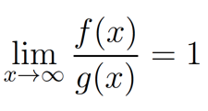
BST: Mathematical Analysis
Comparison Counting. If N distinct keys are inserted into a BST, the expected average number of compares per insert is C(N) ~ 2 ln N = Θ(log N)
Will discuss this proof briefly towards the end of this course.
Tree Height. If N distinct keys are inserted in random order, expected tree height H(N) ~ 4.311 ln N (see Reed, 2003).
Recall tilde notation from Asymptotics 3 lecture:
Similar to BigTheta, but don’t throw away the multiplicative constant.
Formal definition: f(x) ~ g(x) means that

Slide 47
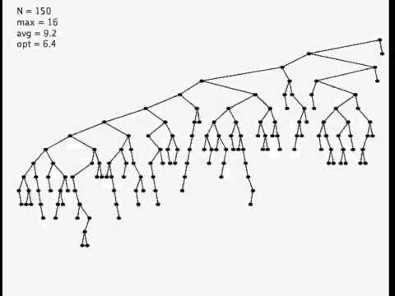
BST Deletion Demo
Surprising Fact. Trees not balanced! C(N) ~ sqrt(N) per operation.
Open Problem. Find a simple and efficient delete for BSTs.
Video courtesy of Kevin Wayne (Princeton University)

Slide 48
Summary
Binary search trees: Efficient data structures for supporting insertion and search.
Operations on “Bushy” BSTs are logarithmic time.
Insertion of random data yields a bushy BST.
On random data, order of growth for get/put operations is logarithmic.
Performance issues:
“Spindly” trees have linear performance.
Hibbard deletion results in order of growth that is sqrt(N).
Nobody knows how to do better on simple BSTs.
Lab this week: Implementing a BSTMap.
Next time: Fixing these performance issues.
Notes:
Sp15 note (?): This lecture is only 45 minutes long (taking it slow)

Slide 49
BST Implementation Tips

Slide 50
Tips for BST Lab
Code from class was “naked recursion”. Your BSTMap will not be.
For each public method, e.g. put(K key, V value), create a private recursive method, e.g. put(K key, V value, Node n)
When inserting, always set left/right pointers, even if nothing is actually changing.
Avoid “arms length base cases”. Don’t check if left or right is null!
static BST insert(BST T, Key ik) {
if (T == null)
return new BST(ik);
if (ik ≺ T.label()))
T.left = insert(T.left, ik);
else if (ik ≻ T.label())
T.right = insert(T.right, ik);
return T;
}
Avoid “arms length base cases”.
if (T.left == null)
T.left = new BST(ik);
else if (T.right == null)
T.right = new BST(ik);
Always set, even if nothing changes!

Slide 51
Citations
Probably photoshopped binary tree: http://cs.au.dk/~danvy/binaries.html
Demo movies for binary search tree operations: Kevin Wayne (Princeton University)

